Slide 1
Assignment - II
Notes:
Was not able to get the percentage values in the complete note. Request support in the same.

Slide 2
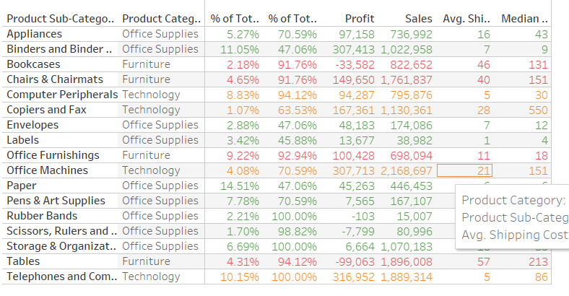
Notes:
Was not able to get the percentage values in the complete note. Request support in the same.

Slide 3
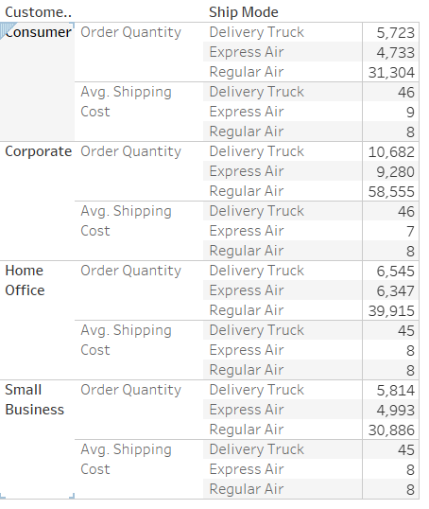
Notes:
Was not able to get the same as shown in the file shared by Amit. Request support in the same.

Slide 4
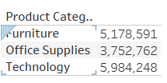
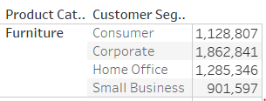
Import – Superstore_Canada.xls (Sheet – Orders) and answer the following questions:
1. What is the total sales of the store?
1491601
2. What is the total sales of product category = “Furniture”?
5178591
3. What is the total sales of product category = “Furniture” sold to Customer Segment = “Corporate”?
1862841
Notes:
Was not able to get the percentage values in the complete note. Request support in the same.

Slide 5
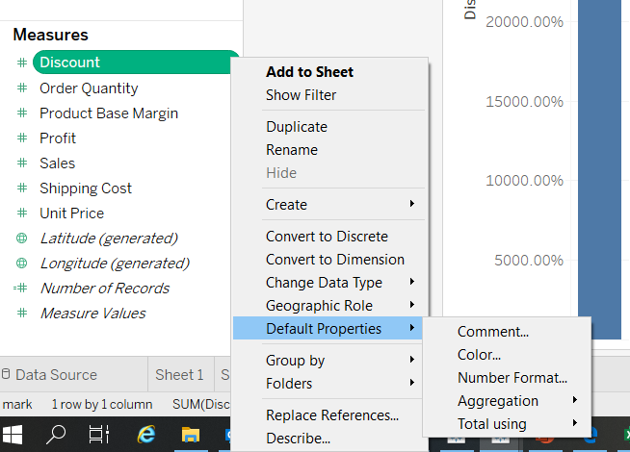
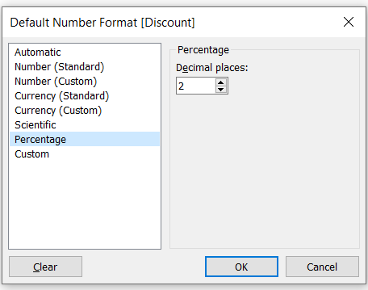
4. Set the default number format of Discount to percentage with 2 decimal places.
Steps to set the above –
->Click on the arrow in the Discount pill in the global measure data pane
->Default Properties
->Number Format
->Click on Percentage & add decimals to 2

Slide 6
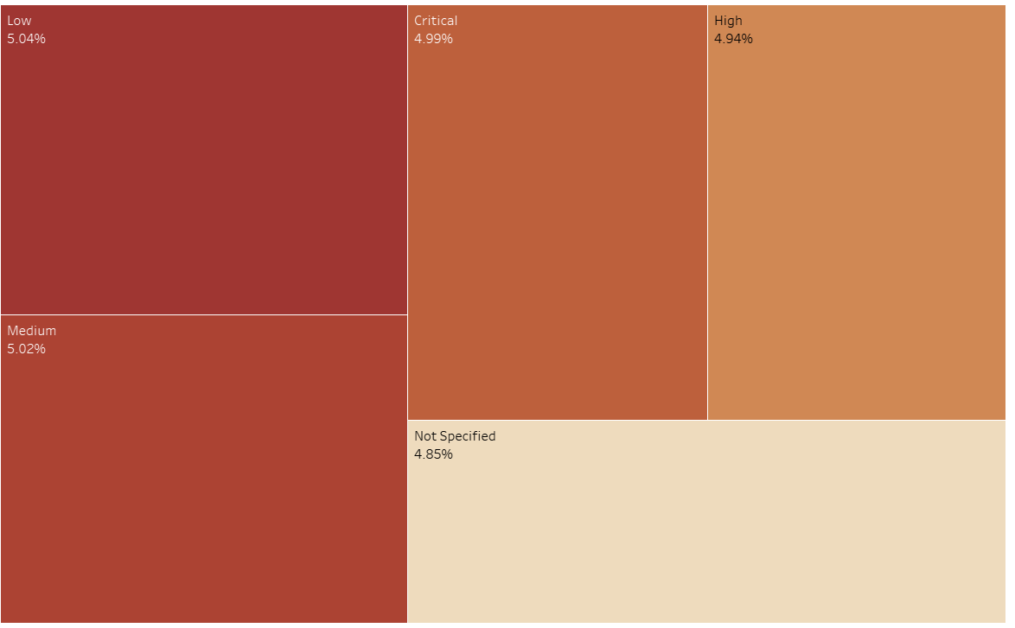
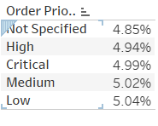
Find average discount on each order priority. Which order priority has highest average discount?
Below is the Average order priority & Low order priority has the highest discount of 5.04%

Slide 7




Import – Superstore_Canada.csv and answer the following questions:
A. For Product Container = “Large Box” which Ship Mode has lowest average shipping cost?
Express Air
B. For Product Container = “Medium Box” which Ship Mode has lowest average shipping cost? Regular Air
C. Which Ship Mode uses only “Jumbo” sized Product Containers?
Delivery Truck
D. Which Ship Mode doesn’t entertain “Jumbo” sized Product Containers?
Express Air

